Slide 1
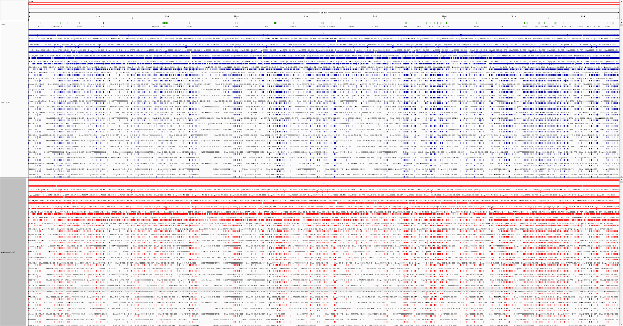
Canis lupus familiaris Chromosome 2 gene model comparison
Jochum, Michael D. CG1808 29 April 2018
Notes:
Length (bps) 85,426,708
Coding genes 739
Non coding genes 470
Small non coding genes 116
Long non coding genes 338
Misc non coding genes 16
Pseudogenes 25
Short Variants 220,003

Slide 2
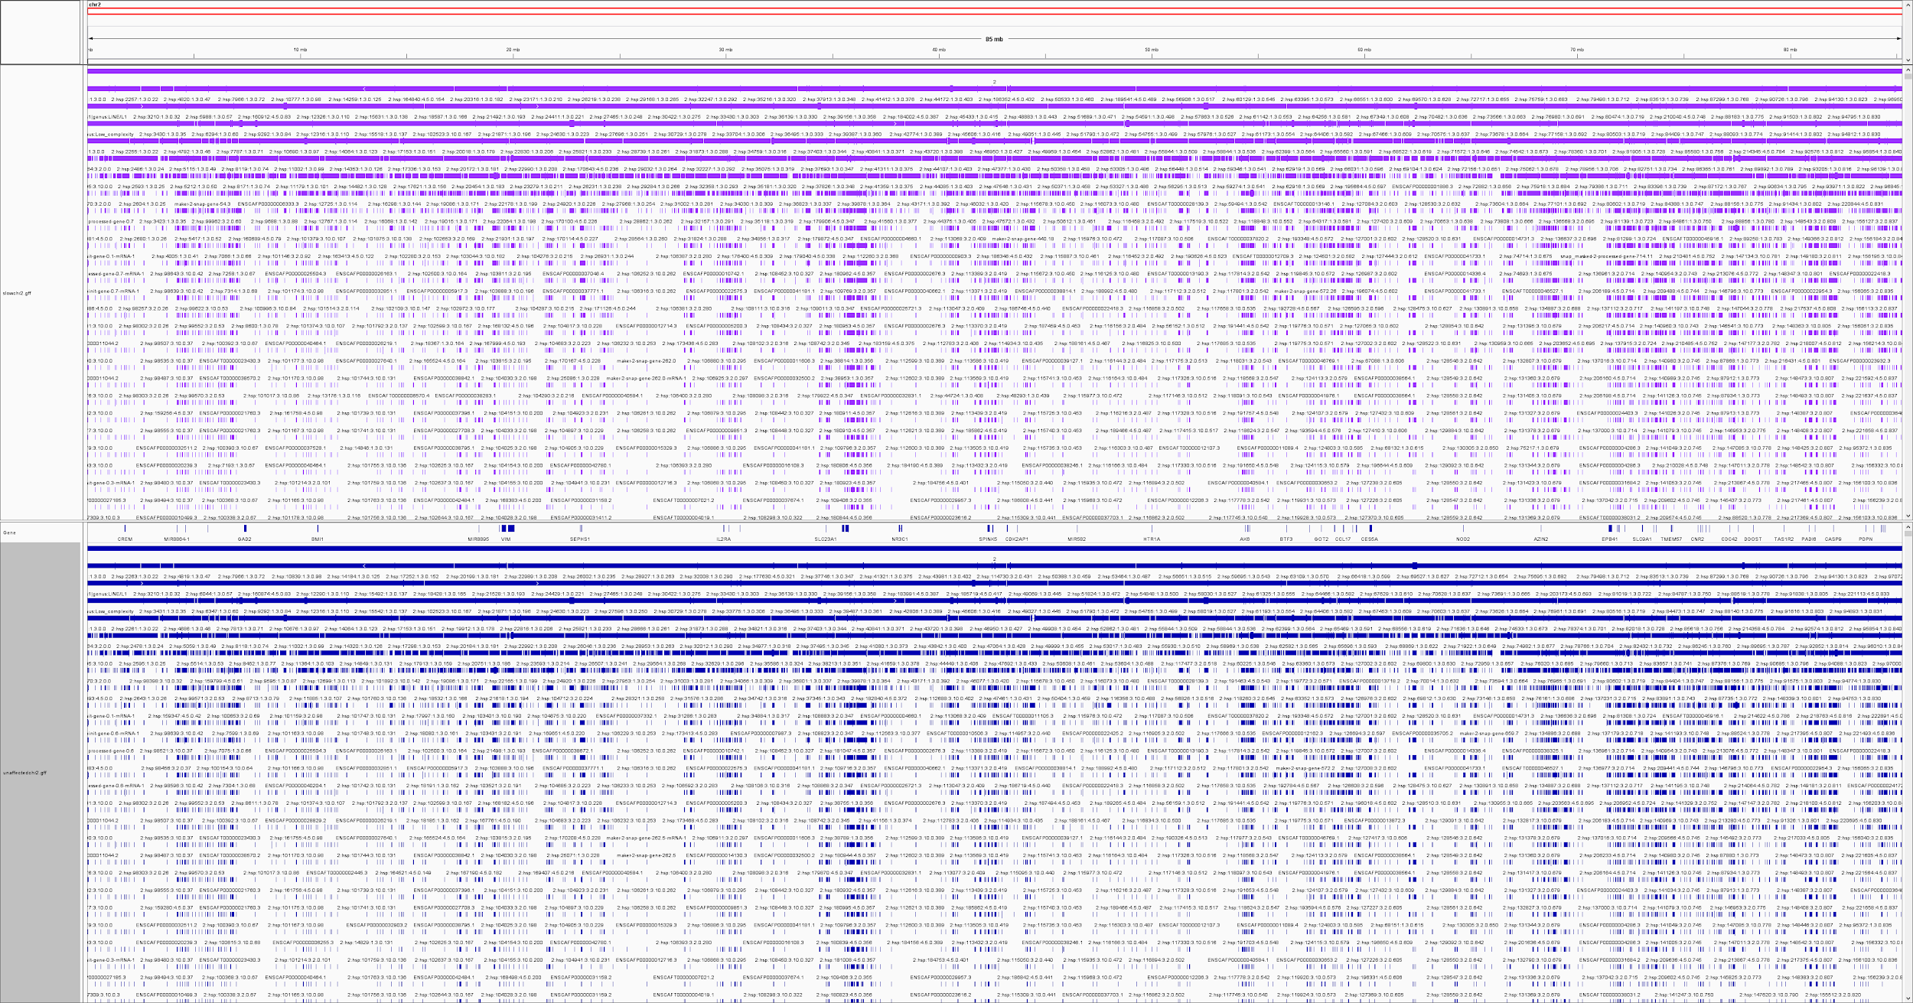
Canis lupus familiaris Chromosome 2 gene model comparison
Jochum, Michael D. CG1808 29 April 2018
Notes:
Length (bps) 85,426,708
Coding genes 739
Non coding genes 470
Small non coding genes 116
Long non coding genes 338
Misc non coding genes 16
Pseudogenes 25
Short Variants 220,003

Slide 3
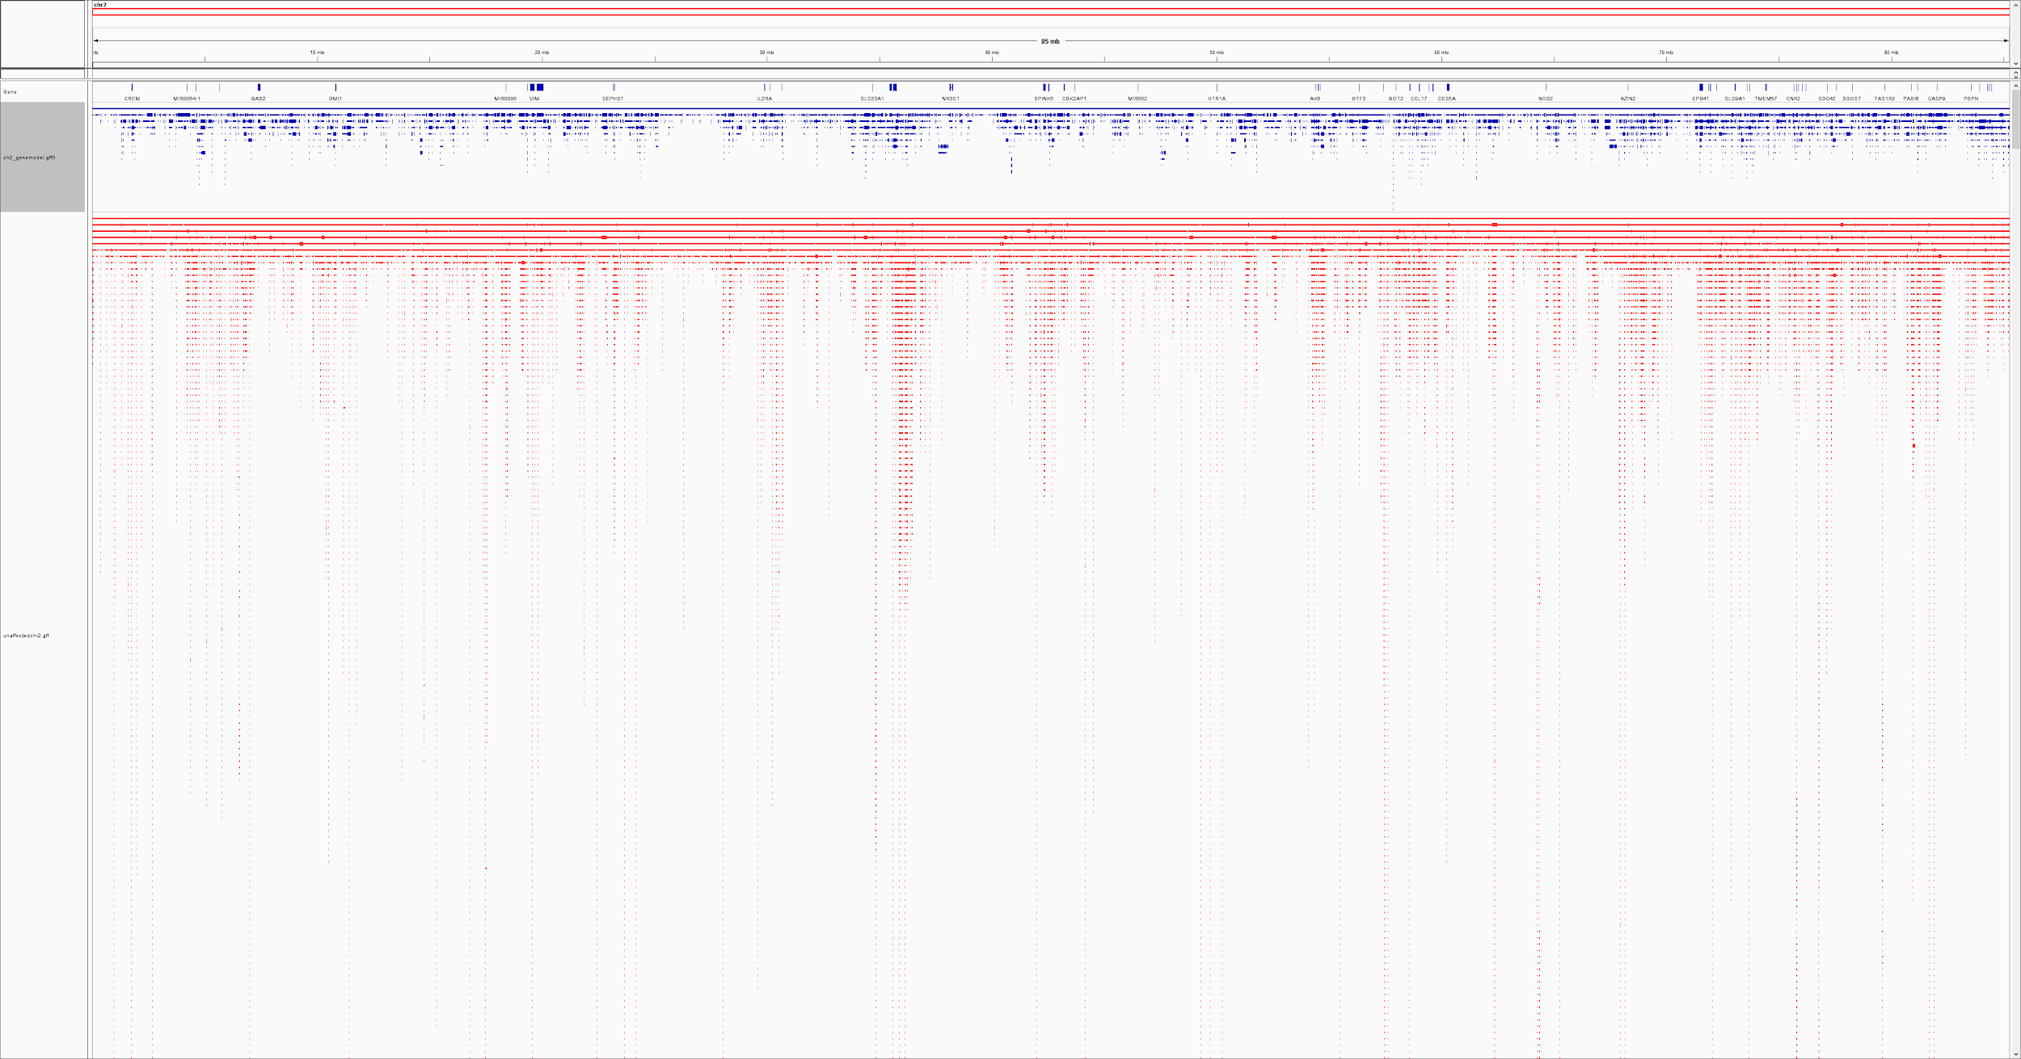
Canis lupus familiaris Chromosome 2 gene model comparison
Jochum, Michael D. CG1808 29 April 2018
Notes:
Length (bps) 85,426,708
Coding genes 739
Non coding genes 470
Small non coding genes 116
Long non coding genes 338
Misc non coding genes 16
Pseudogenes 25
Short Variants 220,003

Slide 4
# gffcompare v0.10.1 | Command line was:
#gffcompare -r unaffectedchr2.gff -o fast_vs_unaff fastchr2.gff
#
#= Summary for dataset: fastchr2.gff
# Query mRNAs : 1034 in 1034 loci (796 multi-exon transcripts)
# (0 multi-transcript loci, ~1.0 transcripts per locus)
# Reference mRNAs : 1034 in 1034 loci (796 multi-exon)
# Super-loci w/ reference transcripts: 1034
#-----------------| Sensitivity | Precision |
Base level: 100.0 | 100.0 |
Exon level: 100.0 | 100.0 |
Intron level: 100.0 | 100.0 |
Intron chain level: 100.0 | 100.0 |
Transcript level: 100.0 | 100.0 |
Locus level: 100.0 | 100.0 |
Matching intron chains: 796
Matching transcripts: 1034
Matching loci: 1034
Missed exons: 0/6460 ( 0.0%)
Novel exons: 0/6460 ( 0.0%)
Missed introns: 0/5426 ( 0.0%)
Novel introns: 0/5426 ( 0.0%)
Missed loci: 0/1034 ( 0.0%)
Novel loci: 0/1034 ( 0.0%)
Total union super-loci across all input datasets: 1034
1034 out of 1034 consensus transcripts written in fast_vs_unaff.annotated.gtf (0 discarded as redundant)
# gffcompare v0.10.1 | Command line was: #gffcompare -r unaffectedchr2.gff -o slow_vs_unaff slowchr2.gff # #= Summary for dataset: slowchr2.gff # Query mRNAs : 1034 in 1034 loci (796 multi-exon transcripts) # (0 multi-transcript loci, ~1.0 transcripts per locus) # Reference mRNAs : 1034 in 1034 loci (796 multi-exon) # Super-loci w/ reference transcripts: 1034 #-----------------| Sensitivity | Precision | Base level: 100.0 | 100.0 | Exon level: 100.0 | 100.0 | Intron level: 100.0 | 100.0 | Intron chain level: 100.0 | 100.0 | Transcript level: 100.0 | 100.0 | Locus level: 100.0 | 100.0 | Matching intron chains: 796 Matching transcripts: 1034 Matching loci: 1034 Missed exons: 0/6460 ( 0.0%) Novel exons: 0/6460 ( 0.0%) Missed introns: 0/5426 ( 0.0%) Novel introns: 0/5426 ( 0.0%) Missed loci: 0/1034 ( 0.0%) Novel loci: 0/1034 ( 0.0%) Total union super-loci across all input datasets: 1034 1034 out of 1034 consensus transcripts written in slow_vs_unaff.annotated.gtf (0 discarded as redundant) slow_vs_unaff.stats (END)

Slide 5
# gffcompare v0.10.1 | Command line was: #gffcompare -r unaffected_out.gtf -o fast_vs_unaff fast_out.gtf # #= Summary for dataset: fast_out.gtf # Query mRNAs : 98983 in 76026 loci (49987 multi-exon transcripts) # (10729 multi-transcript loci, ~1.3 transcripts per locus) # Reference mRNAs : 53881 in 34894 loci (45545 multi-exon) # Super-loci w/ reference transcripts: 30912 #-----------------| Sensitivity | Precision | Base level: 87.9 | 55.1 | Exon level: 94.2 | 79.5 | Intron level: 96.3 | 94.5 | Intron chain level: 83.0 | 75.6 | Transcript level: 83.8 | 45.6 | Locus level: 95.1 | 43.6 | Matching intron chains: 37787 Matching transcripts: 45177 Matching loci: 33176 Missed exons: 3510/265778 ( 1.3%) Novel exons: 47226/316131 ( 14.9%) Missed introns: 4102/210726 ( 1.9%) Novel introns: 2425/214850 ( 1.1%) Missed loci: 519/34894 ( 1.5%) Novel loci: 40748/76026 ( 53.6%) Total union super-loci across all input datasets: 75130 98983 out of 98983 consensus transcripts written in fast_vs_unaff.annotated.gtf (0 discarded as redundant)
# gffcompare v0.10.1 | Command line was:
#gffcompare -r ../unaffected_out.gtf -o slow_vs_unaffected ./slow_out.gtf
#= Summary for dataset: ./slow_out.gtf
# Query mRNAs : 87236 in 65097 loci (49198 multi-exon transcripts)
# (10447 multi-transcript loci, ~1.3 transcripts per locus)
# Reference mRNAs : 53881 in 34894 loci (45545 multi-exon)
# Super-loci w/ reference transcripts: 30980
#-----------------| Sensitivity | Precision |
Base level: 88.5 | 57.4 |
Exon level: 94.2 | 82.8 |
Intron level: 96.2 | 94.8 |
Intron chain level: 82.9 | 76.7 |
Transcript level: 83.7 | 51.7 |
Locus level: 95.1 | 50.9 |
Matching intron chains: 37735
Matching transcripts: 45119
Matching loci: 33185
Missed exons: 3503/265778 ( 1.3%)
Novel exons: 35920/303457 ( 11.8%)
Missed introns: 4131/210726 ( 2.0%)
Novel introns: 2163/213883 ( 1.0%)
Missed loci: 501/34894 ( 1.4%)
Novel loci: 29869/65097 ( 45.9%)
Total union super-loci across all input datasets: 64256
87236 out of 87236 consensus transcripts written in slow_vs_unaffected.annotated.gtf (0 discarded as redundant)

Slide 6
